Slide 1
JAVASCRIPT
FUNDAMENTALS – PART 1

Slide 2

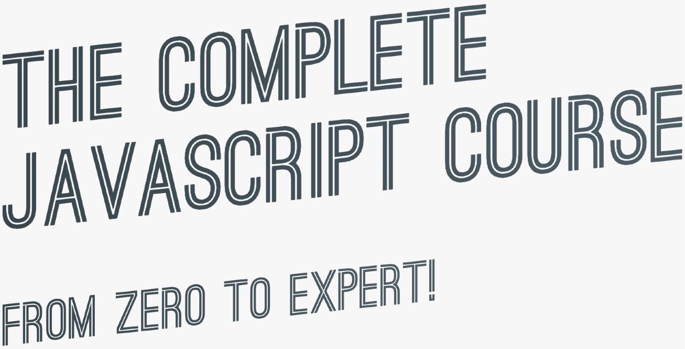

SECTION
JAVASCRIPT FUNDAMENTALS – PART 1
LECTURE
A BRIEF INTRODUCTION TO JAVASCRIPT

Slide 3




WHAT IS JAVASCRIPT?
We don’t have to worry about complex stuff like memory management
JAVASCRIPT
JAVASCRIPT IS A HIGH-LEVEL, OBJECT-ORIENTED, MULTI-PARADIGM PROGRAMMING LANGUAGE.
We can use different styles of programming
Based on objects, for storing most kinds of data
Instruct computer to do things

Slide 4


THE ROLE OF JAVASCRIPT IN WEB DEVELOPMENT
NOUNS
<p></p>
means “paragraph”
CONTENT
VERBS
p.hide();
means “hide the paragraph”
ADJECTIVES
p {color: red}
means “the paragraph text is red”
PRESENTATION
PROGRAMMING LANGUAGE: BUILDING WEB APPLICATIONS

Slide 5
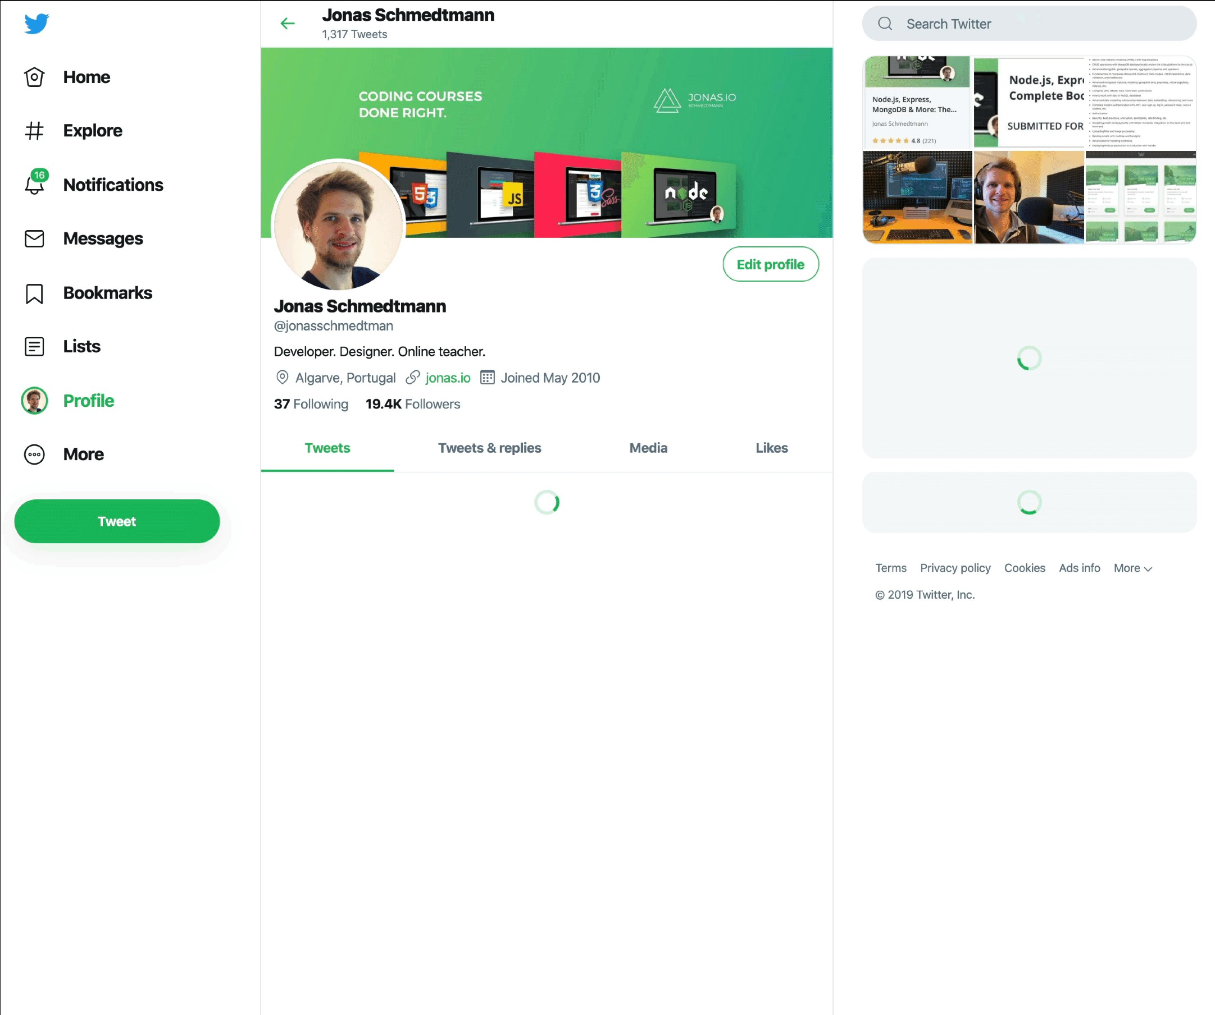
EXAMPLE OF DYNAMIC EFFECTS / WEB APPLICATION
Display user info on hover
Show spinner + loading data in the background
Show spinner + loading data in the background
Show data after loading
Show tweet box after clicking
Display tweets after loading data

Slide 6

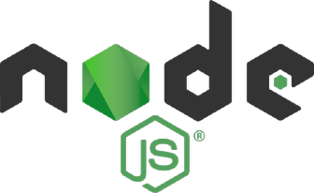





THERE IS NOTHING YOU CAN’T DO WITH JAVASCRIPT (WELL, ALMOST…)
Front-end apps
Back-end apps
Dynamic effects and web applications in the
browser
Web applications on web servers
THIS COURSE
100% based on JavaScript. They might go away, but JavaScript won’t!
Native mobile applications
Native desktop applications

Slide 7


JAVASCRIPT RELEASES... (MORE ABOUT THIS LATER)
Biggest update to the language EVER
New updates to JS every single year
ES6/ ES2015
ES7/ ES2016
ES8/ ES2017
ES9/ ES2018
ES10/ ES2019
ES11/ ES2020
...
ES5
...
Modern JavaScript
ECMAScript
Learn modern JavaScript from the beginning, but without forgetting the older parts!
Let’s finally get started!

Slide 8
SECTION
JAVASCRIPT FUNDAMENTALS – PART 1
LECTURE
DATA TYPES

Slide 9
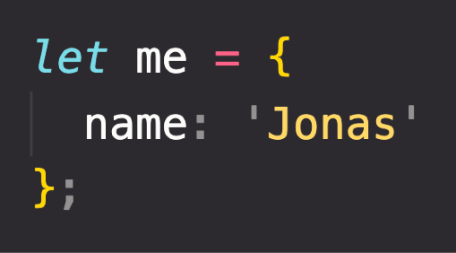
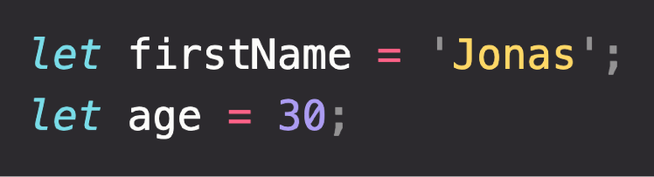
OBJECTS AND PRIMITIVES
VALUE
EVERYTHING ELSE
OBJECT
OR
PRIMITIVE

Slide 10

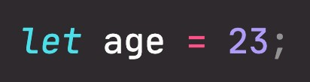

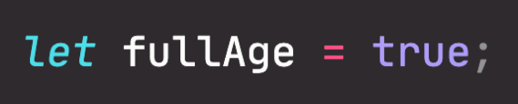
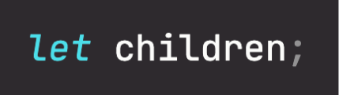

THE 7 PRIMITIVE DATA TYPES
Number: Floating point numbers
String: Sequence of characters
Used for decimals and integers
Used for text
Boolean: Logical type that can only be true or false Used for taking decisions
Undefined: Value taken by a variable that is not yet defined (‘empty value’)
Null: Also means ‘empty value’
Symbol (ES2015): Value that is unique and cannot be changed [Not useful for now]
BigInt (ES2020): Larger integers than the Number type can hold
JavaScript has dynamic typing: We do not have to manually define the data type of the value stored in a variable. Instead, data types are determined automatically.
Value has type, NOT variable!

Slide 11
SECTION
JAVASCRIPT FUNDAMENTALS – PART 1
LECTURE
JAVASCRIPT RELEASES: ES5, ES6+ AND ESNEXT

Slide 12
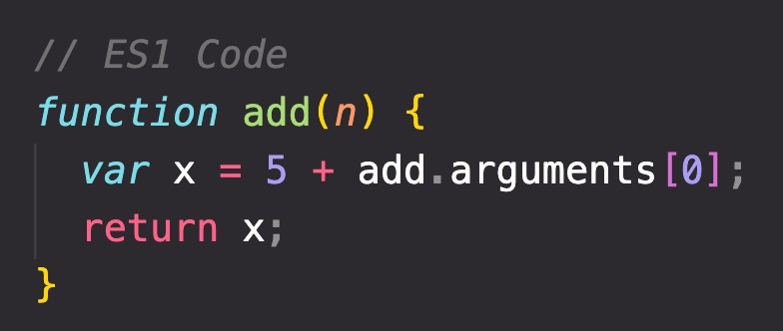



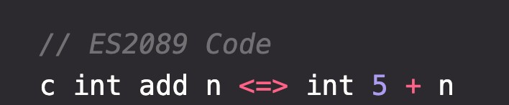

BACKWARDS COMPATIBILITY: DON’T BREAK THE WEB!
Modern JavaScript Engine
BACKWARDS COMPATIBLE
1997
2020
Old features are never removed; Not really new versions, just
incremental updates (releases)
Websites keep working forever!
DON’T BREAK THE WEB!
Modern JavaScript Engine
NOT FORWARDS COMPATIBLE
2020
2089

Slide 13
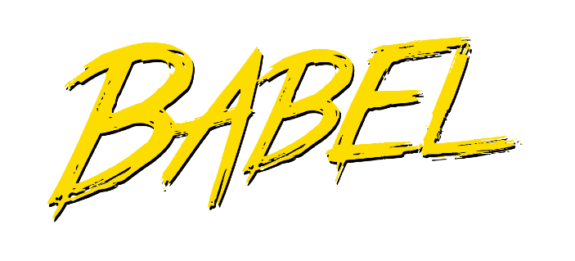
HOW TO USE MODERN JAVASCRIPT TODAY
During development: Simply use the latest Google Chrome!
During production: Use Babel to transpile and polyfill your code (converting back to ES5 to ensure browser compatibility for all users).
Fully supported in all browsers (down to IE 9 from 2011);
Ready to be used today
ES5
ES6/ES2015
↓
ES2020
ES6+: Well, supported in all modern browsers; No support in older browsers;
Can use most features in production with transpiling and polyfilling
ESNext: Future versions of the language (new feature proposals that reach Stage 4);
Can already use some features in production with transpiling and polyfilling.
ES2021 – ∞
Will add new videos

Slide 14
MODERN JAVASCRIPT FROM THE BEGINNING
Learn modern JavaScript from the beginning!
But, also learn how some things used to be done before modern JavaScript (e.g. const & let vs var and function constructors vs ES6 class).
3 reasons why we should not forget the Good Ol’ JavaScript:
You will better understand how JavaScript actually works; Many tutorials and code you find online today are still in ES5; When working on old codebases, these will be written in ES5.

Slide 15
JAVASCRIPT
FUNDAMENTALS – PART 2

Slide 16
SECTION
JAVASCRIPT FUNDAMENTALS – PART 2
LECTURE
FUNCTIONS CALLING OTHER FUNCTIONS

Slide 17
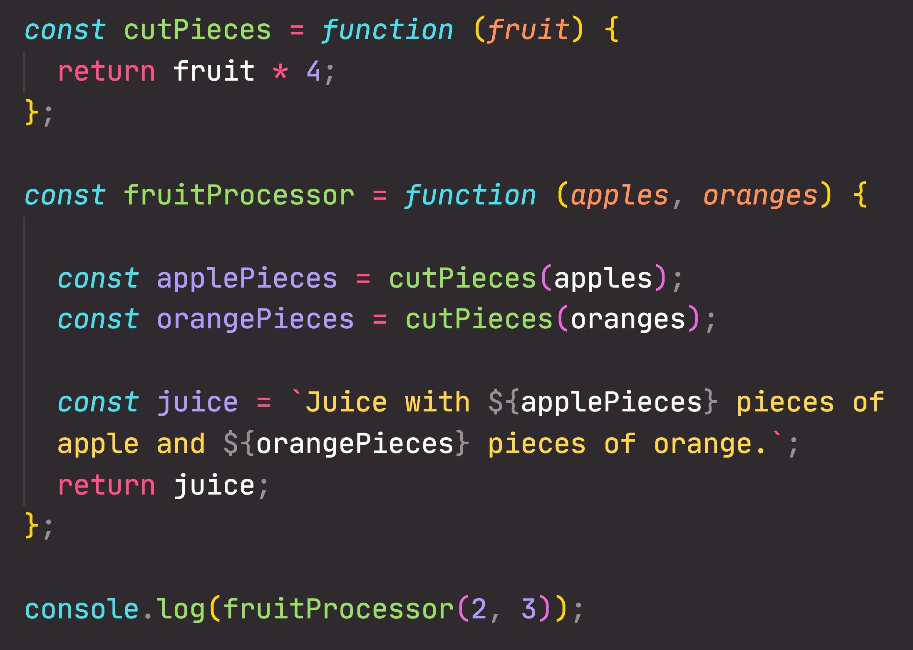

CALLING A FUNCTION INSIDE A FUNCTION: DATA FLOW
2
2
8
2
8
3
8
2

Slide 18
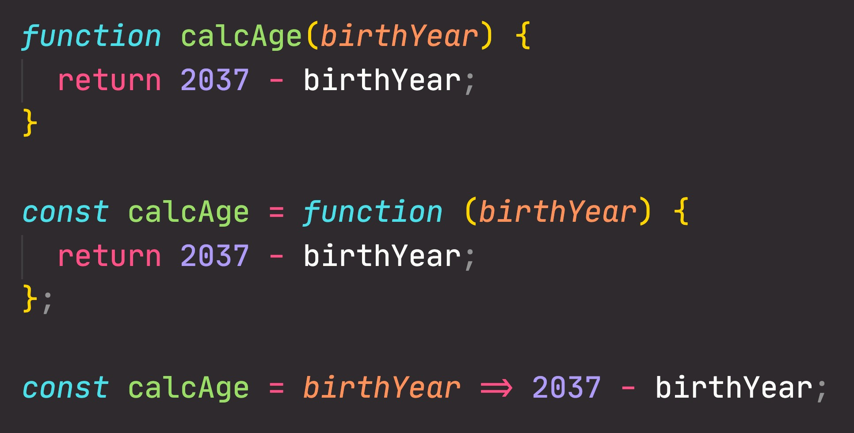
FUNCTIONS REVIEW; 3 DIFFERENT FUNCTION TYPES
Function declaration
Function that can be used before it’s declared
Function expression
Essentially a function
value stored in a variable
Arrow function
Great for a quick one-line functions. Has no this keyword (more later...)
Three different ways of writing functions, but they all work in a similar way: receive input data, transform data, and then output data.

Slide 19
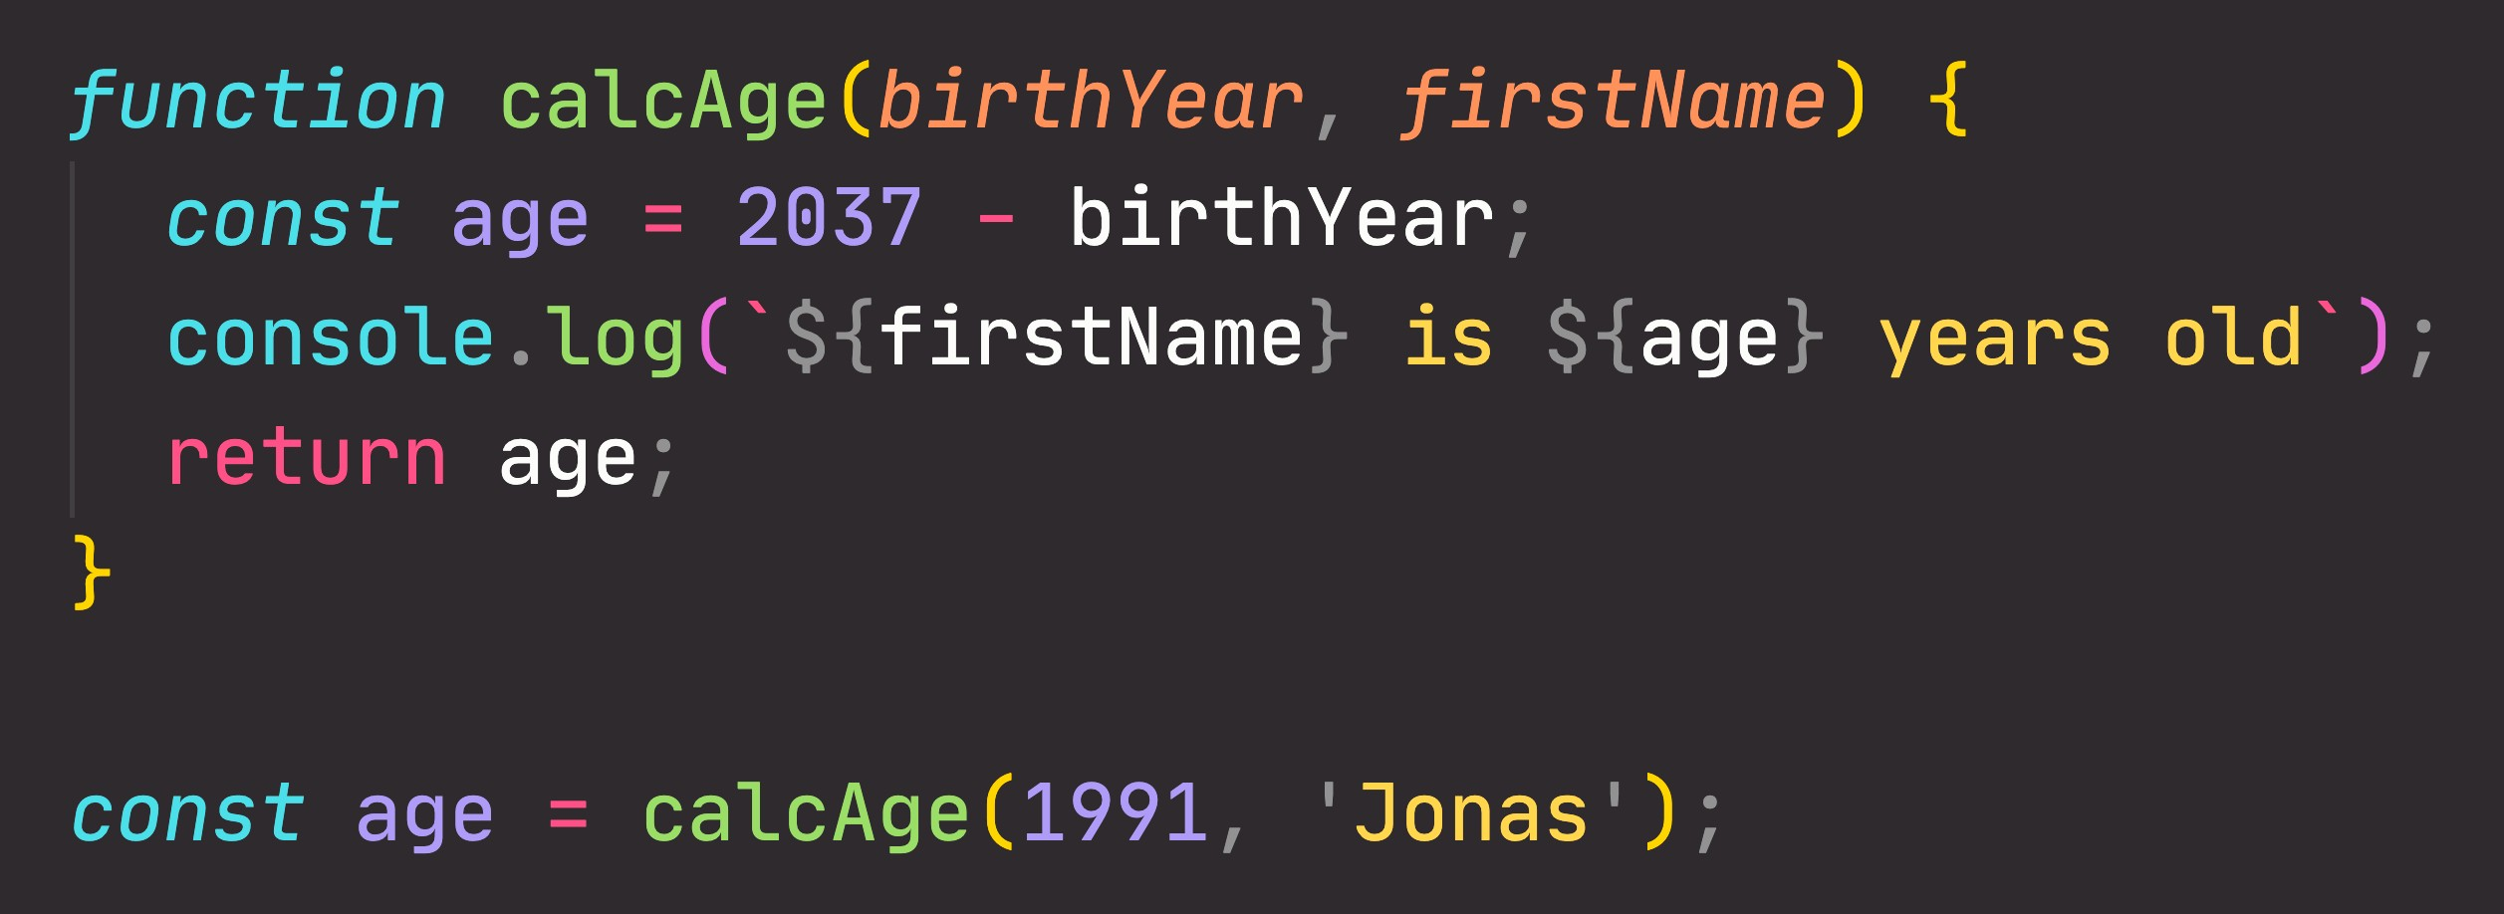
FUNCTIONS REVIEW: ANATOMY OF A FUNCTION
Parameters: placeholders to receive input
values. Like local variables of a function
Function body: block of code that we want to reuse. Processes the function’s input data
Function name
return statement to output a value from the function and terminate execution
Calling, running or invoking the function, using ()
Variable to save returned value (function output)
Arguments: actual values of function parameters, to input data

Slide 20
SECTION
DEVELOPER SKILLS & EDITOR SETUP
LECTURE
DEBUGGING (FIXING ERRORS)

Slide 21
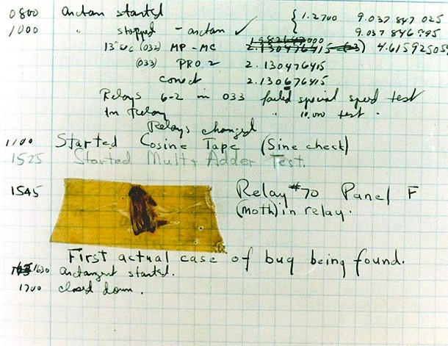

WHAT IS A SOFTWARE BUG?
Software bug: Defect or problem in a computer program. Basically, any unexpected or unintended behavior of a computer program is a software bug.
Bugs are completely normal in software development!
Previous example: “We need a function that reverses whatever we pass into it”
reverse([1, 3, 5, 7])
Unexpected result: the array is scrambled, NOT reversed. So there is a bug in the reverse function
[5, 1, 7, 3]
A real bug which was causing an error in Harvard’s computer in the 1940s
Debugging: Process of finding, fixing and preventing bugs.

Slide 22
THE DEBUGGING PROCESS
Becoming aware that there is a bug
Isolating where exactly the bug is happening in code
Correct the bug
Preventing it from happening again
IDENTIFY
FIND
FIX
PREVENT
During development
Developer console (simple code)
Replace wrong solution with new correct solution
Searching for the same bug in similar code
Testing software
Debugger (complex code)
User reports during production
Writing tests using testing software
Context: browsers, users, etc.

Slide 23
JAVASCRIPT IN THE BROWSER:
DOM AND EVENTS FUNDAMENTALS

Slide 24
SECTION
JAVASCRIPT IN THE BROWSER: DOM AND EVENTS FUNDAMENTALS
LECTURE
WHAT'S THE DOM AND DOM MANIPULATION

Slide 25

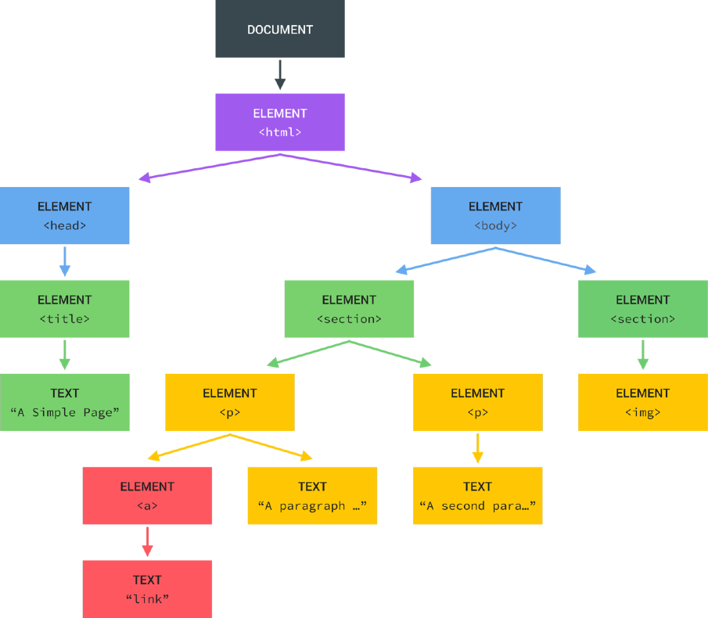
WHAT IS THE DOM?
Tree structure, generated by browser on HTML load
DOM
Document object model: structured representation of html documents. Allows JavaScript to access html elements and styles to manipulate them.
Change text, HTML attributes, and even CSS styles

Slide 26
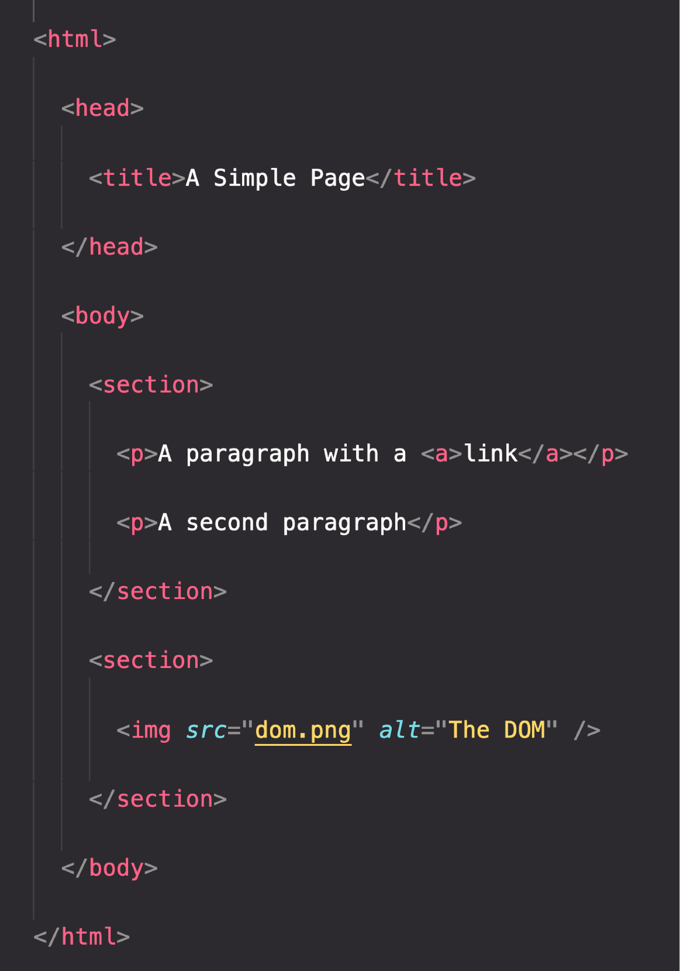

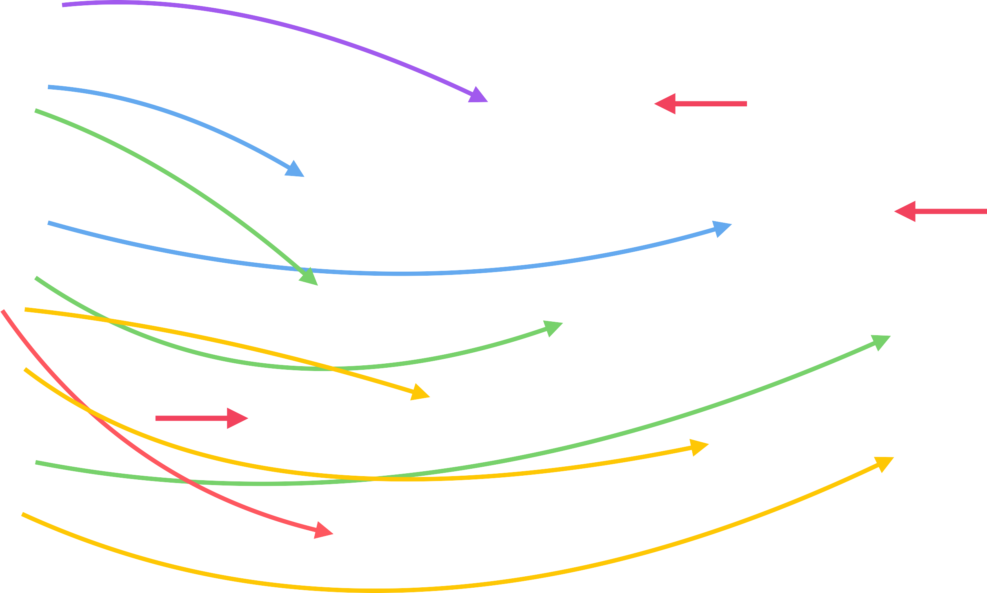
THE DOM TREE STRUCTURE
Special object that is the entry point to the DOM. Example: document.querySelector()

Slide 27

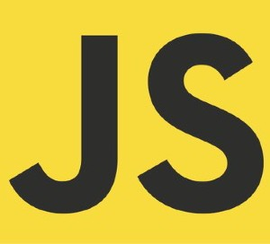





DOM ! ==JAVASCRIPT
DOM Methods and Properties for DOM Manipulation
NOT PART OF
For example
document.querySelector()
API: Application Programming Interface
WEB APIs
DOM Methods and Properties
Timers
CAN INTERACT WITH
Fetch

Slide 28
SECTION
HOW JAVASCRIPT WORKS BEHIND THE SCENES
LECTURE
THE JAVASCRIPT ENGINE AND RUNTIME

Slide 29



WHAT IS A JAVASCRIPT ENGINE?
JS ENGINE
ENGINE
PROGRAM THAT EXECUTES
JAVASCRIPT CODE.
Object in memory
Execution context
Example: V8 Engine
CALL STACK
HEAP
How is it compiled?
Where our code is executed
Where objects are stored

Slide 30


COMPUTER SCIENCE SIDENOTE: COMPILATION VS. INTERPRETATION
Compilation: Entire code is converted into machine code at once, and written to a binary file that can be executed by a computer.
Source code
STEP 1
Portable file:
machine code
STEP 2
Program running
COMPILATION
EXECUTION
Can happen way after compilation
Interpretation: Interpreter runs through the source code and executes it line by line.
Source code
STEP 1
Program running
EXECUTION LINE BY LINE
Code still needs to be converted to machine code
Just-in-time (JIT) compilation: Entire code is converted into machine code at once, then executed immediately.
Source code
STEP 1
Machine code
STEP 2
Program running
COMPILATION
EXECUTION
NOT a portable file
Happens immediately

Slide 31
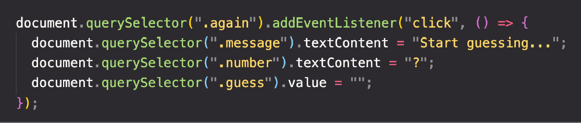
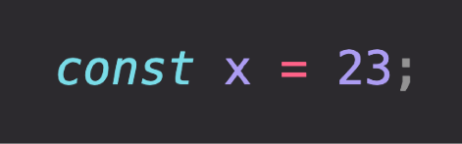
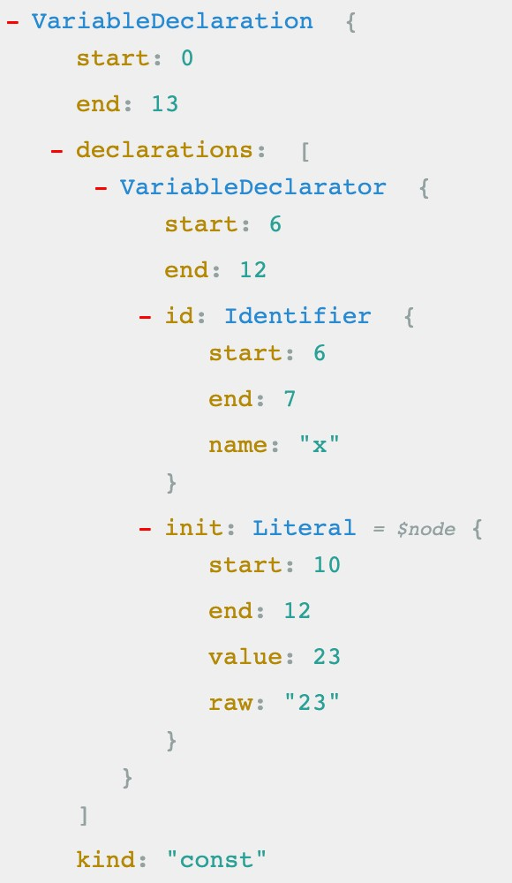


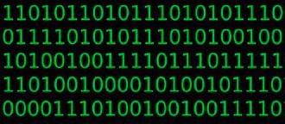

MODERN JUST-IN-TIME COMPILATION OF JAVASCRIPT
“JavaScript is an interpreted language”
ENGINE
AST Example
Happens in special threads that we can’t access from code
Parsing
Example
AST
Compilation
Just-in-time compilation
Optimization
Execution
Happens in Call Stack
During execution!

Slide 32


THE BIGGER PICTURE: JAVASCRIPT RUNTIME
RUNTIME IN THE BROWSER
Functionalities provided to
Container including all the things
the engine, accessible on
ENGINE
that we need to use Jav_{W}aS_{E}cr_{B}ipt_{APIs}
window object
(in this case in the browser)
DOM
Timers
...
Fetch API
EVENT LOOP
Essential for non-blocking concurrency model
CALLBACK QUEUE
click
timer
data
...
onClick
HEAP
CALL STACK
Example: Callback function from DOM event listener

Slide 33
THE BIGGER PICTURE: JAVASCRIPT RUNTIME
RUNTIME IN NODE.JS
WEB APIs
C++ BINDINGS & THREAD POOL
ENGINE
EVENT LOOP
CALLBACK QUEUE
click
timer
data
...
HEAP
CALL STACK

Slide 34
SECTION
HOW JAVASCRIPT WORKS BEHIND THE SCENES
LECTURE
EXECUTION CONTEXTS AND THE CALL STACK

Slide 35

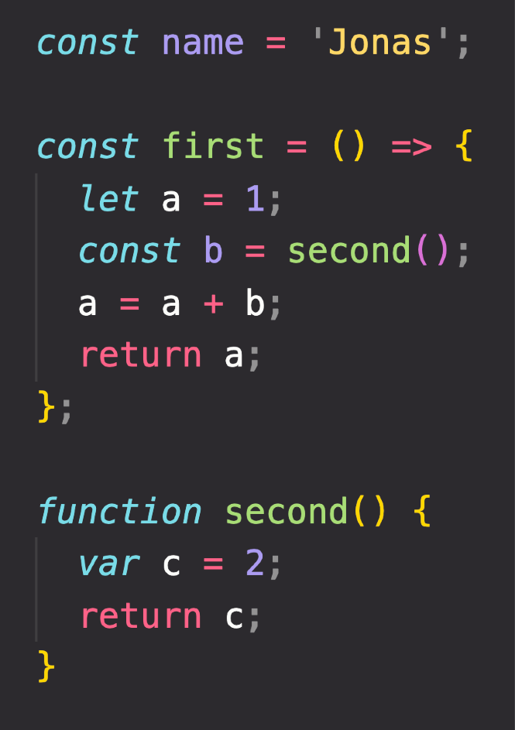



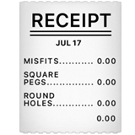


WHAT IS AN EXECUTION CONTEXT?
Compilation
EXECUTION CONTEXT
Human-readable code:
Environment in which a piece of JavaScript is executed. Stores all the necessary information for some code to be executed.
“JavaScript code"
Creation of global execution context (for top-level code)
EXECUTION
NOT inside a function
+ +
Execution of top-level code
(inside global EC)
Pizza “execution context”
Exactly one global execution context (EC): Default context, created for code that is not inside any function (top-level).
Function body only executed when called!
Execution of functions and waiting for callbacks
One execution context per function: For each function call, a new execution context is created.
All together make the call stack
Example: click event callback

Slide 36
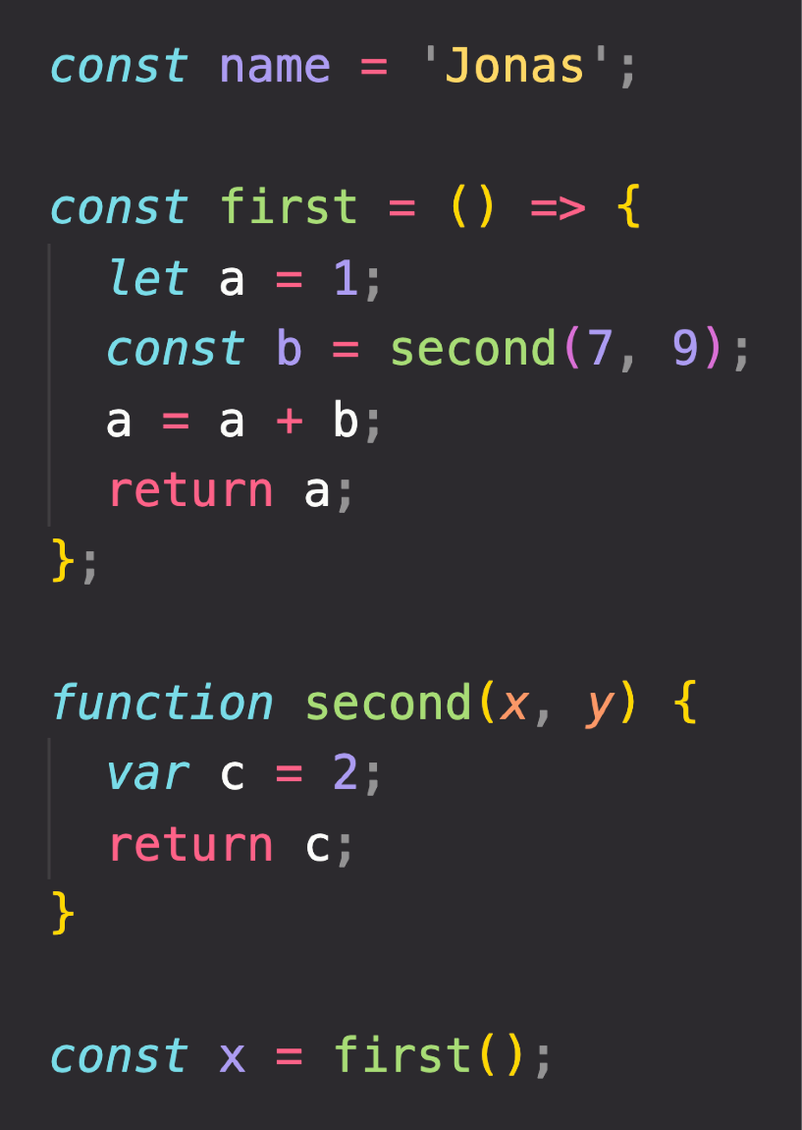
EXECUTION CONTEXT IN DETAIL
Global
Literally the function code
WHAT’S INSIDE EXECUTION CONTEXT?
name = ‘Jonas’ first = <function> second = <function> x = <unknown>
1
Variable Environment
let, const and var declarations Functions
arguments object
Need to run
first() first
first()
a = 1
b = <unknown>
Need to run
second() first
2
Scope chain
NOT in arrow functions!
3
this keyword
second()
c = 2
arguments = [7, 9]
Generated during “creation phase”, right before execution
Array of passed arguments. Available in all “regular” functions (not arrow)
(Technically, values only become known during execution)

Slide 37
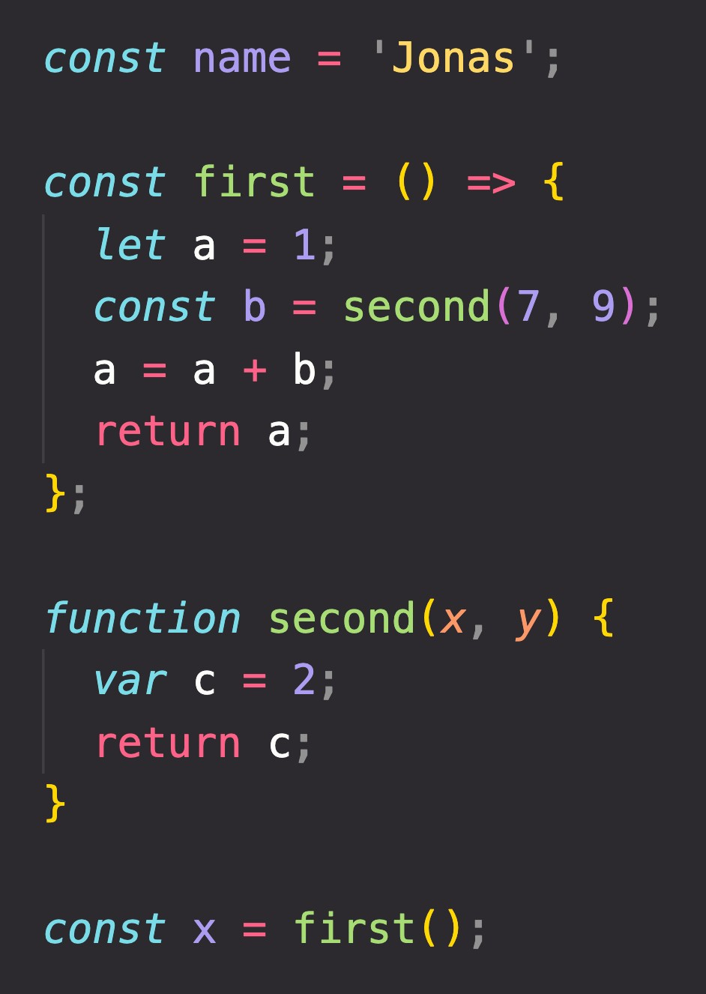


THE CALL STACK
Compiled code starts execution
second()
first()
ENGINE
Global
“Place” where execution contexts get
CALL STACK
stacked on top of each other, to keep
track of where we are in the execution

Slide 38
SECTION
HOW JAVASCRIPT WORKS BEHIND THE SCENES
LECTURE
SCOPE AND THE SCOPE CHAIN

Slide 39



SCOPING AND SCOPE IN JAVASCRIPT: CONCEPTS
EXECUTION CONTEXT
Variable environment
this keyword
Scope chain
SCOPE CONCEPTS
Scoping: How our program’s variables are organized and accessed. “Where do variables live?” or “Where can we access a certain variable, and where not?”;
Lexical scoping: Scoping is controlled by placement of functions and blocks in the code;
Scope: Space or environment in which a certain variable is declared (variable environment in case of functions). There is global scope, function scope, and block scope;
Scope of a variable: Region of our code where a certain variable can be accessed.

Slide 40
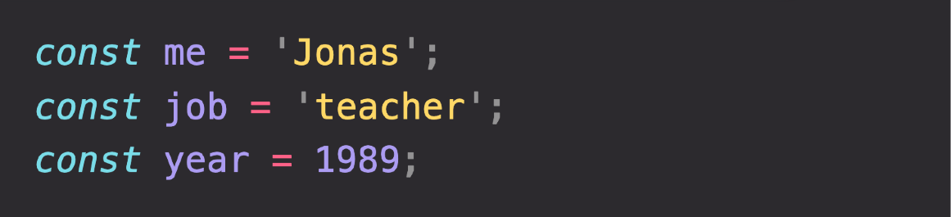
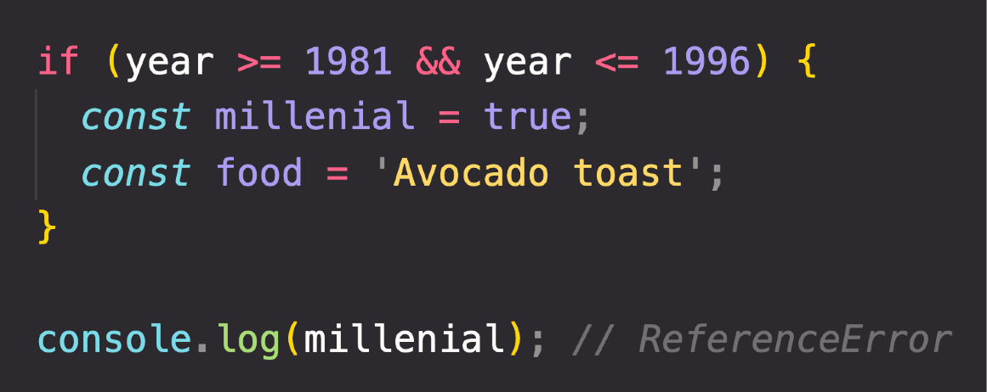

THE 3 TYPES OF SCOPE
FUNCTION SCOPE
Variables are accessible only
inside function, NOT outside
Also called local scope
GLOBAL SCOPE
BLOCK SCOPE (ES6)
Example: if block, for loop block, etc.
Outside of any function or block
Variables declared in global scope are accessible everywhere
Variables are accessible only
inside block (block scoped)
HOWEVER, this only applies to
let and const variables!
Functions are also block scoped
(only in strict mode)

Slide 41
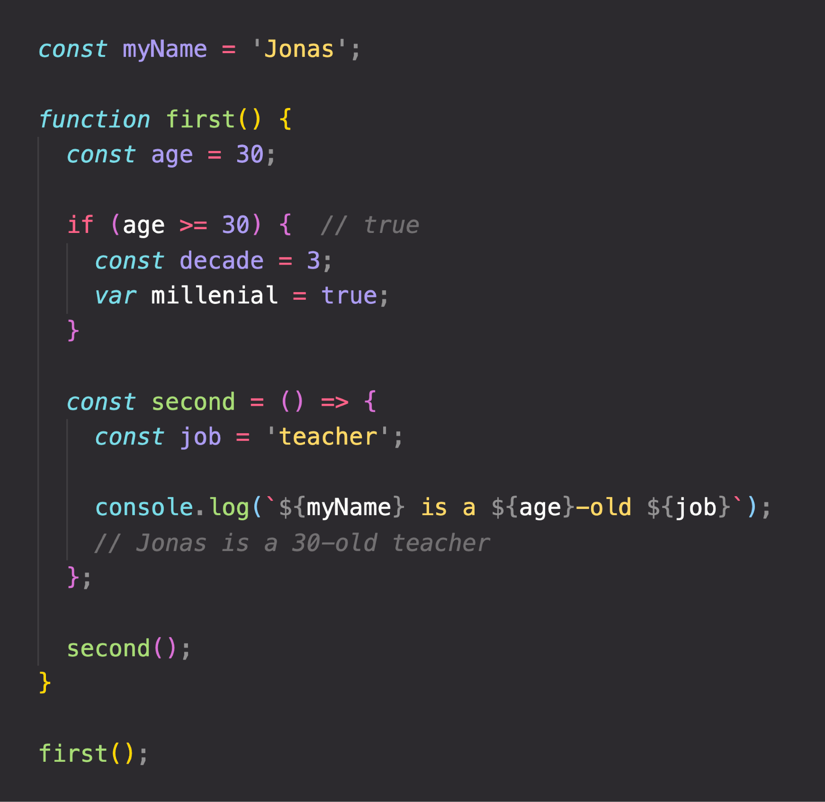
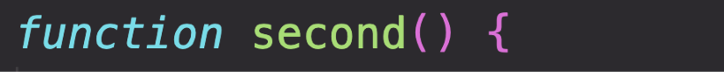

THE SCOPE CHAIN
(Considering only variable declarations)
Global scope
Global variable
myName = “Jonas”
CHAIN
SCOPE CHAIN
let and const are block-scoped
SCOPE
first() scope
Variables not in current scope
age = 30
millennial = true
var is function-scoped
IN
myName = “Jonas”
Scope has access to variables from all outer scopes
LOOKUP
VARIABLE
if block scope
second() scope
decade = 3
job = “teacher”
age = 30
millennial = true
age = 30
millennial = true
myName = “Jonas”
myName = “Jonas”

Slide 42
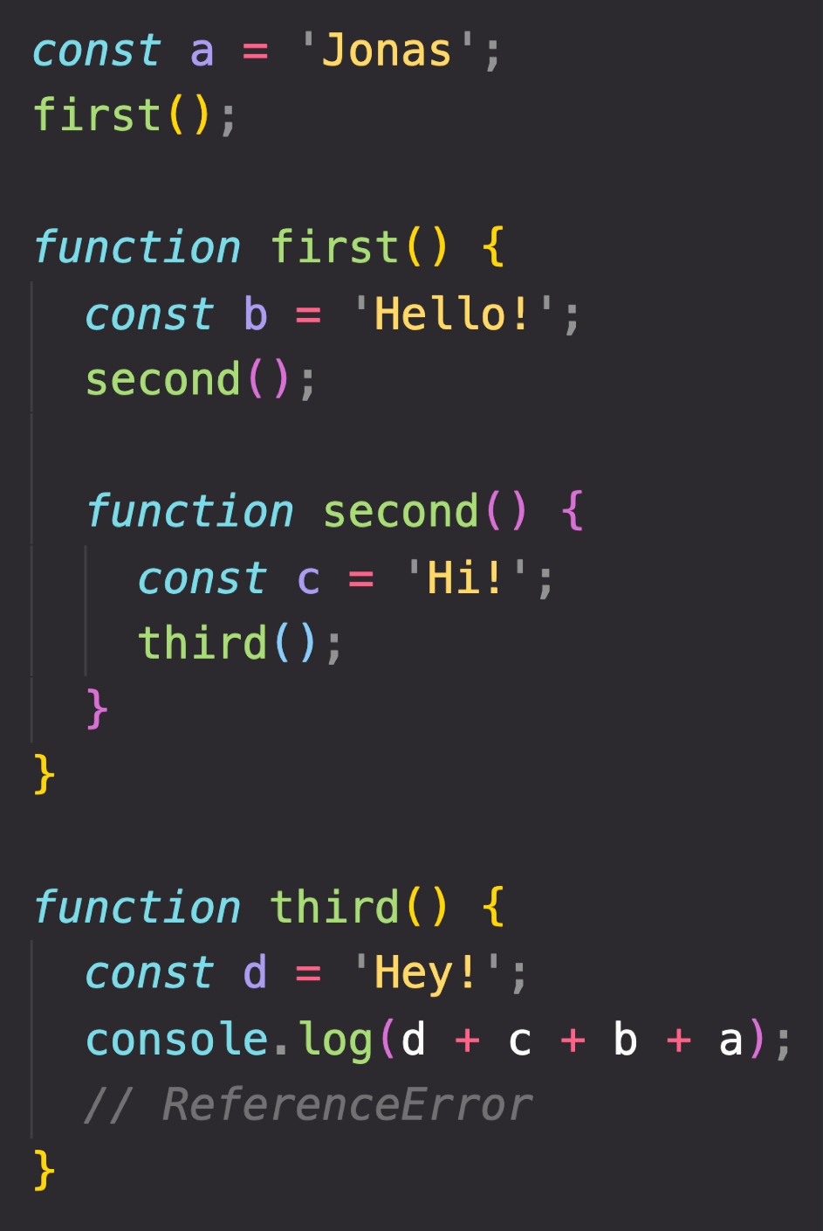
SCOPE CHAIN VS. CALL STACK
Global scope
a = “Jonas”
first = <function>
third = <function>
third() EC
d = “Hey!”
second() EC
first() scope
b = “Hello!” second = <function>
a = “Jonas” first = <function> third = <function>
third() scope
d = “Hey!”
a = “Jonas” first = <function> third = <function>
c = “Hi!”
first() EC
b = “Hello!”
second = <function>
SCOPE CHAIN
Order in which functions are written in the code
Global EC
second() scope
c = “Hi!”
b = “Hello!” second = <function>
a = “Jonas” first = <function> third = <function>
a = “Jonas”
first = <function>
third = <function>
CALL STACK
Order in which functions were called
Has nothing to do with order in which functions were called!
c and b can NOT be found in third() scope!
Variable environment (VE)

Slide 43
SECTION
HOW JAVASCRIPT WORKS BEHIND THE SCENES
LECTURE

Slide 44




HOISTING IN JAVASCRIPT
Hoisting: Makes some types of variables accessible/usable in the code before they are actually declared. “Variables lifted to the top of their scope”.
EXECUTION CONTEXT
Scope chain
this keyword
Variable environment
BEHIND THE SCENES
Before execution, code is scanned for variable declarations, and for each variable, a new property is created in the variable environment object.
HOISTED?
INITIAL VALUE
SCOPE
In strict mode.
Otherwise: function!
function declarations
YES
Actual function
Block
var variables
YES
undefined
Function
Technically, yes. But not in practice
let and const variables
NO
<uninitialized>, TDZ
Block
function expressions and arrows
Depends if using var or let/const
Temporal Dead Zone

Slide 45
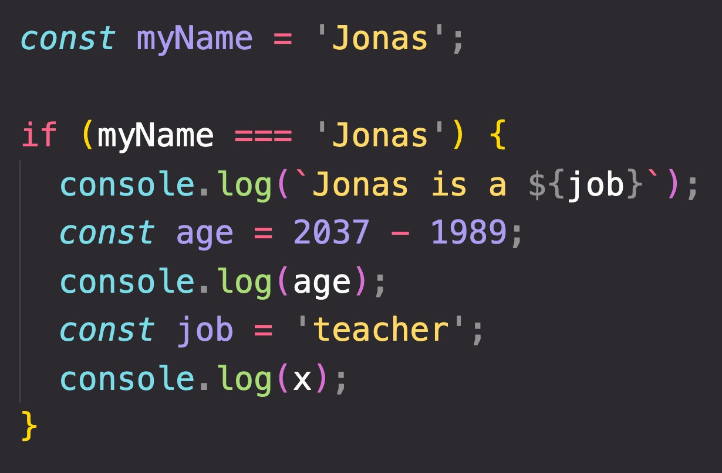
TEMPORAL DEAD ZONE, LET AND CONST
TEMPORAL DEAD ZONE FOR job VARIABLE
Different kinds of error messages:
ReferenceError: Cannot access 'job' before initialization ReferenceError: x is not defined
WHY HOISTING?
WHY TDZ?
Using functions before actual declaration;
var hoisting is just a byproduct.
Makes it easier to avoid and catch errors: accessing variables before declaration is bad practice and should be avoided;
Makes const variables actually work

Slide 46
SECTION
HOW JAVASCRIPT WORKS BEHIND THE SCENES
LECTURE
THE THIS KEYWORD

Slide 47
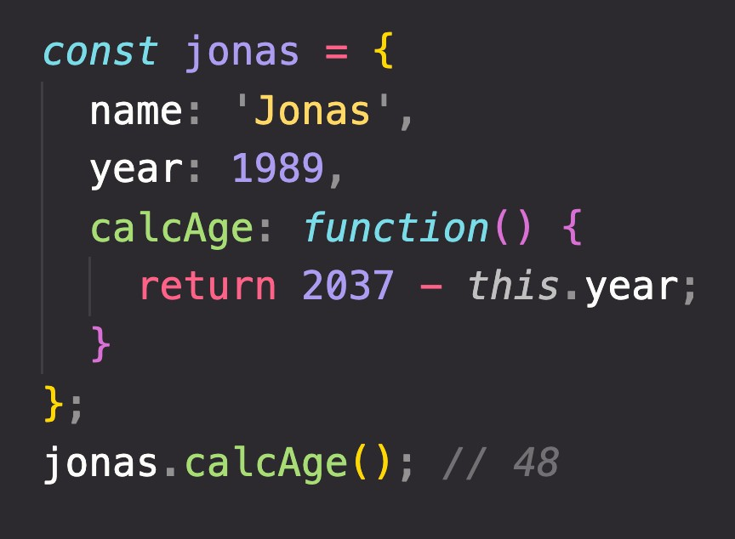

HOW THE THIS KEYWORD WORKS
this keyword/variable: Special variable that is created for every execution context (every function). Takes the value of (points to) the “owner” of the function in which the this keyword is used.
EXECUTION CONTEXT
Variable environment Scope chain
this is NOT static. It depends on how the function is called, and its value is only assigned when the function is actually called.
this keyword
Method example:
Method this = <Object that is calling the method>
Simple function call this = undefined
In strict mode! Otherwise:
window (in the browser)
Don’t get own this
Arrow functions this = <this of surrounding function (lexical this)>
Event listener this = <DOM element that the handler is attached to>
new, call, apply, bind <Later in the course... >
calcAge
is method
jonas
1989
this does NOT point to the function itself, and also NOT the its variable environment!
Way better than using
jonas.year!

Slide 48
GOT QUESTIONS? FEEDBACK?

Slide 49
SECTION
HOW JAVASCRIPT WORKS BEHIND THE SCENES
LECTURE
PRIMITIVES VS. OBJECTS (PRIMITIVE VS. REFERENCE TYPES)

Slide 50
REVIEW: PRIMITIVES, OBJECTS AND THE JAVASCRIPT ENGINE
PRIMITIVES
Number String Boolean Undefined Null Symbol BigInt
OBJECTS
Object literal Arrays Functions Many more…
ENGINE
STORED IN
STORED IN
REFERENCE TYPES
CALL STACK
HEAP
PRIMITIVE TYPES

Slide 51
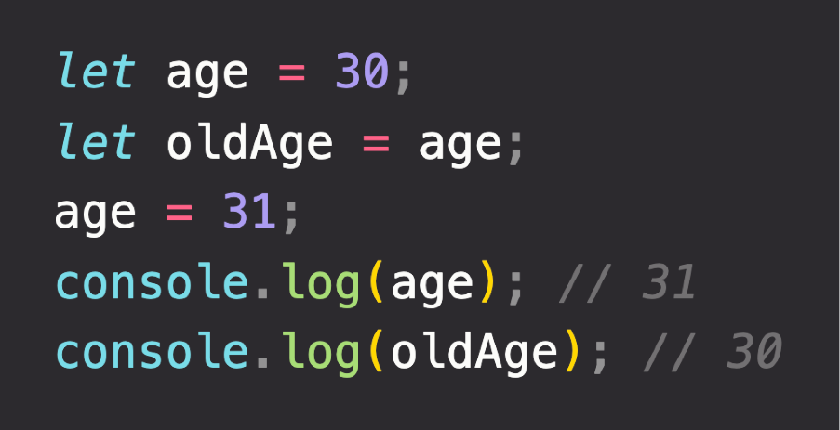


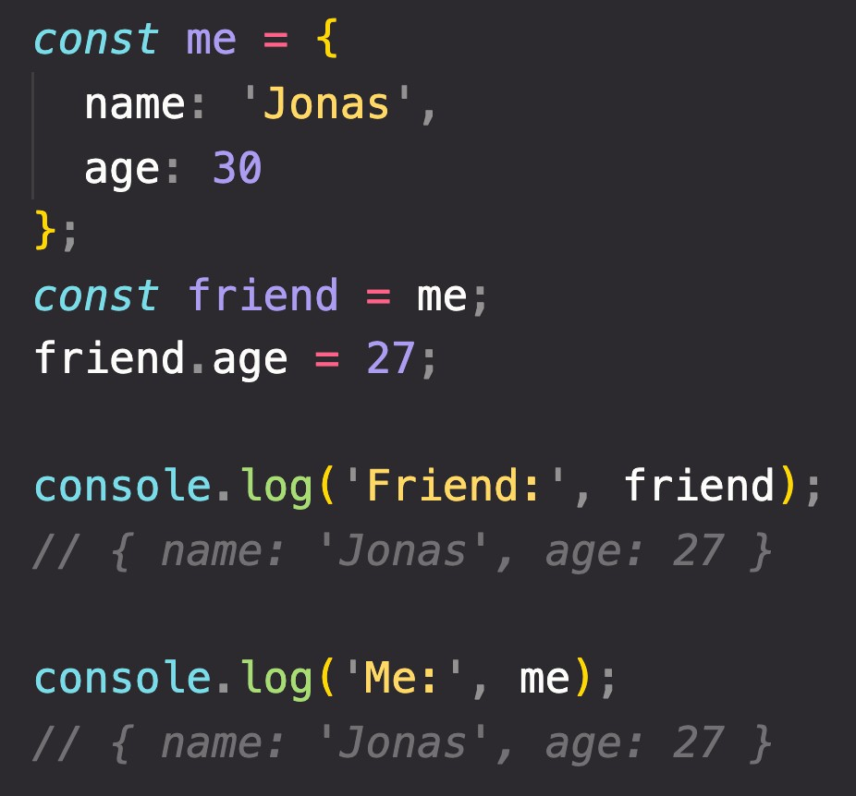
PRIMITIVE VS. REFERENCE VALUES
Primitive values example:
Identifier
Address
Value
Address
Value
age
0001
30 31
{
name: ‘Jonas’; age: 30;
}
D30F
Reference values example:
oldAge
0002
31
Reference to memory address in Heap
27
me
0003
D30F
No problem, because we’re NOT changing the value at address 0003!
friend
CALL STACK
HEAP

Slide 52
“HOW JAVASCRIPT WORKS BEHIND THE SCENES” TOPICS FOR LATER...
1
Prototypal Inheritance
Object Oriented Programming (OOP) With JavaScript
2
Event Loop
Asynchronous JavaScript: Promises, Async/Await and AJAX
3
How the DOM Really Works
Advanced DOM and Events

Slide 53
DATA STRUCTURES, MODERN OPERATORS AND STRINGS

Slide 54
SECTION
DATA STRUCTURES, MODERN OPERATORS AND STRINGS
LECTURE
SUMMARY: WHICH DATA STRUCTURE TO USE?

Slide 55
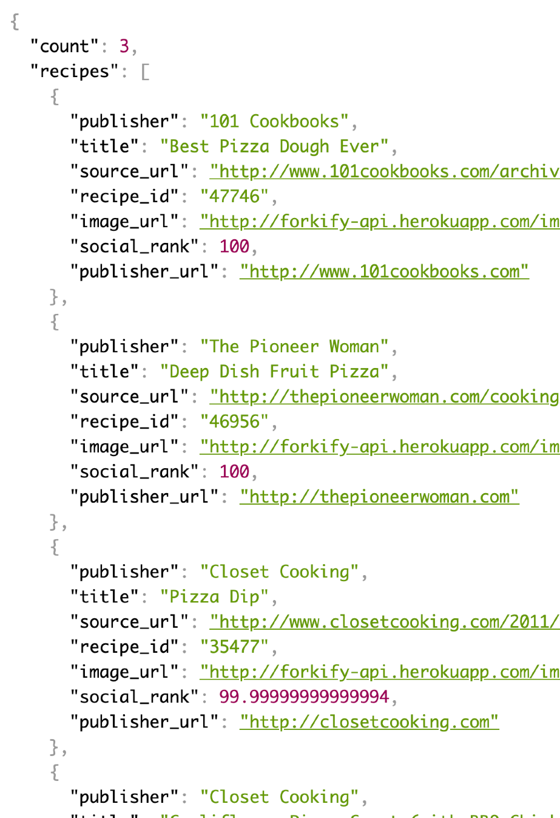
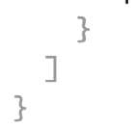

DATA STRUCTURES OVERVIEW
SOURCES OF DATA
From the program itself: Data written directly in source code (e.g. status messages)
From the UI: Data input from the user or data written in DOM (e.g tasks in todo app)
From external sources: Data fetched for example from web API (e.g. recipe objects)
“Object”
Array
Application Programming Interface
“Object”
Collection of data
OTHER BUILT-IN:
WeakMap WeakSet
NON-BUILT IN:
Stacks Queues Linked lists Trees
Hash tables
Data structure
SIMPLE LIST?
KEY/VALUE PAIRS?
Arrays or Sets
Objects or Maps
Keys allow us to
describe values
JSON data format example

Slide 56
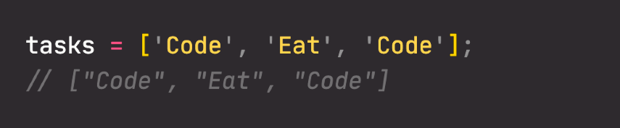
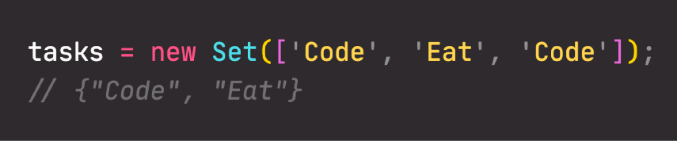
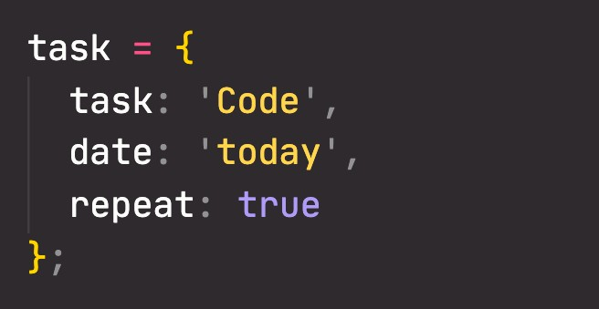
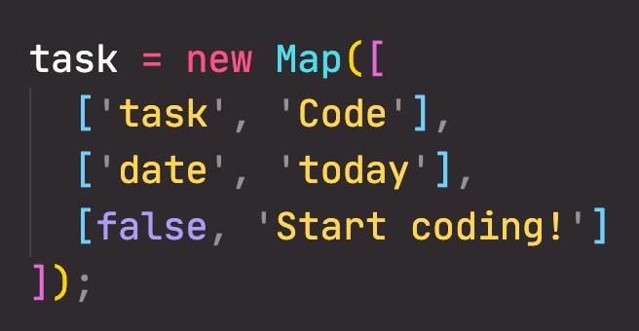
ARRAYS VS. SETS AND OBJECTS VS. MAPS
ARRAYS
VS.
SETS
OBJECTS
VS.
MAPS
Use when you need ordered list of values (might contain duplicates)
Use when you need to
manipulate data
Use when you need to work with unique values
Use when high-performance
is really important
Use to remove duplicates
from arrays
More “traditional” key/value store (“abused” objects)
Easier to write and access values with . and []
Better performance
Keys can have any data type Easy to iterate
Easy to compute size
Use when you need to include functions (methods)
Use when working with JSON (can convert to map)
Use when you simply need to map key to values
Use when you need keys that are not strings

Slide 57
A CLOSER LOOK AT FUNCTIONS

Slide 58
SECTION
A CLOSER LOOK AT FUNCTIONS
LECTURE
FIRST-CLASS AND HIGHER-ORDER FUNCTIONS

Slide 59
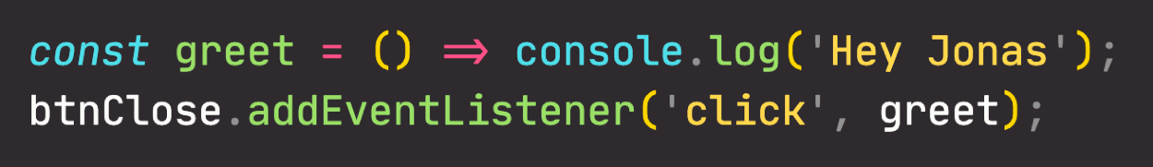
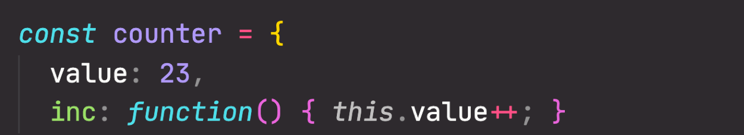


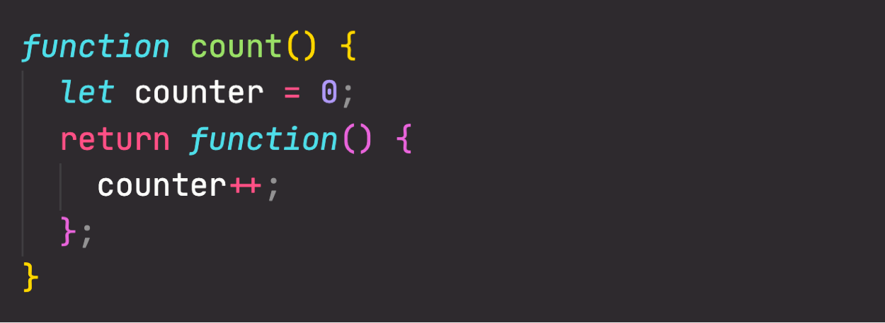

FIRST-CLASS VS. HIGHER-ORDER FUNCTIONS
FIRST-CLASS FUNCTIONS
HIGHER-ORDER FUNCTIONS
JavaScript treats functions as first-class citizens
This means that functions are simply values
Functions are just another “type” of object
Store functions in variables or properties:
A function that receives another function as an argument, that returns a new function, or both
This is only possible because of first-class functions
Function that receives another function
1
Higher-order function
Callback function
Pass functions as arguments to OTHER functions:
2
Function that returns new function
Higher-order function
Returned function
Return functions FROM functions
Call methods on functions:

Slide 60
SECTION
A CLOSER LOOK AT FUNCTIONS
LECTURE
CLOSURES

Slide 61
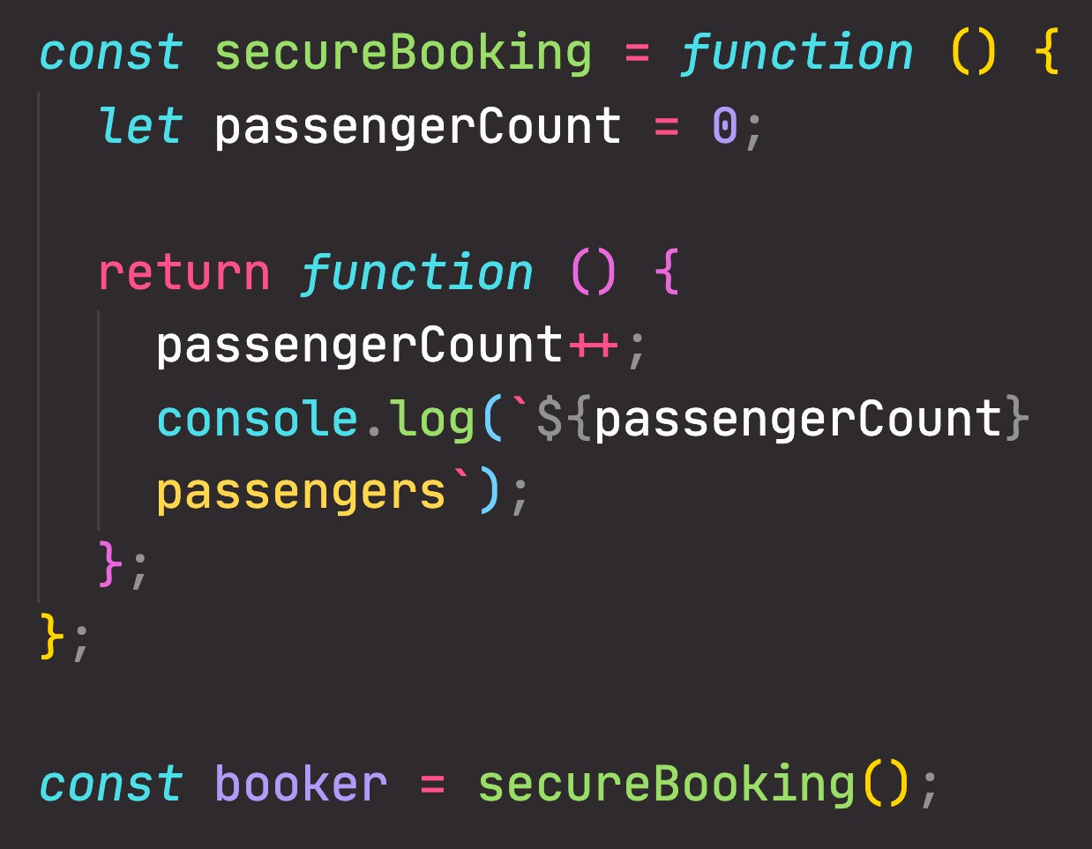
“CREATING” A CLOSURE
Global scope
secureBooking = <f>
booker = <f>
Variable Environment
secureBooking() scope
passengerCount = 0
secureBooking = <f> booker = <f>
secureBooking() EC
passengerCount = 0
Global EC
secureBooking = <f>
booker = <f>
CALL STACK
Order in which functions were called
Order in which functions are written in the code
SCOPE CHAIN

Slide 62
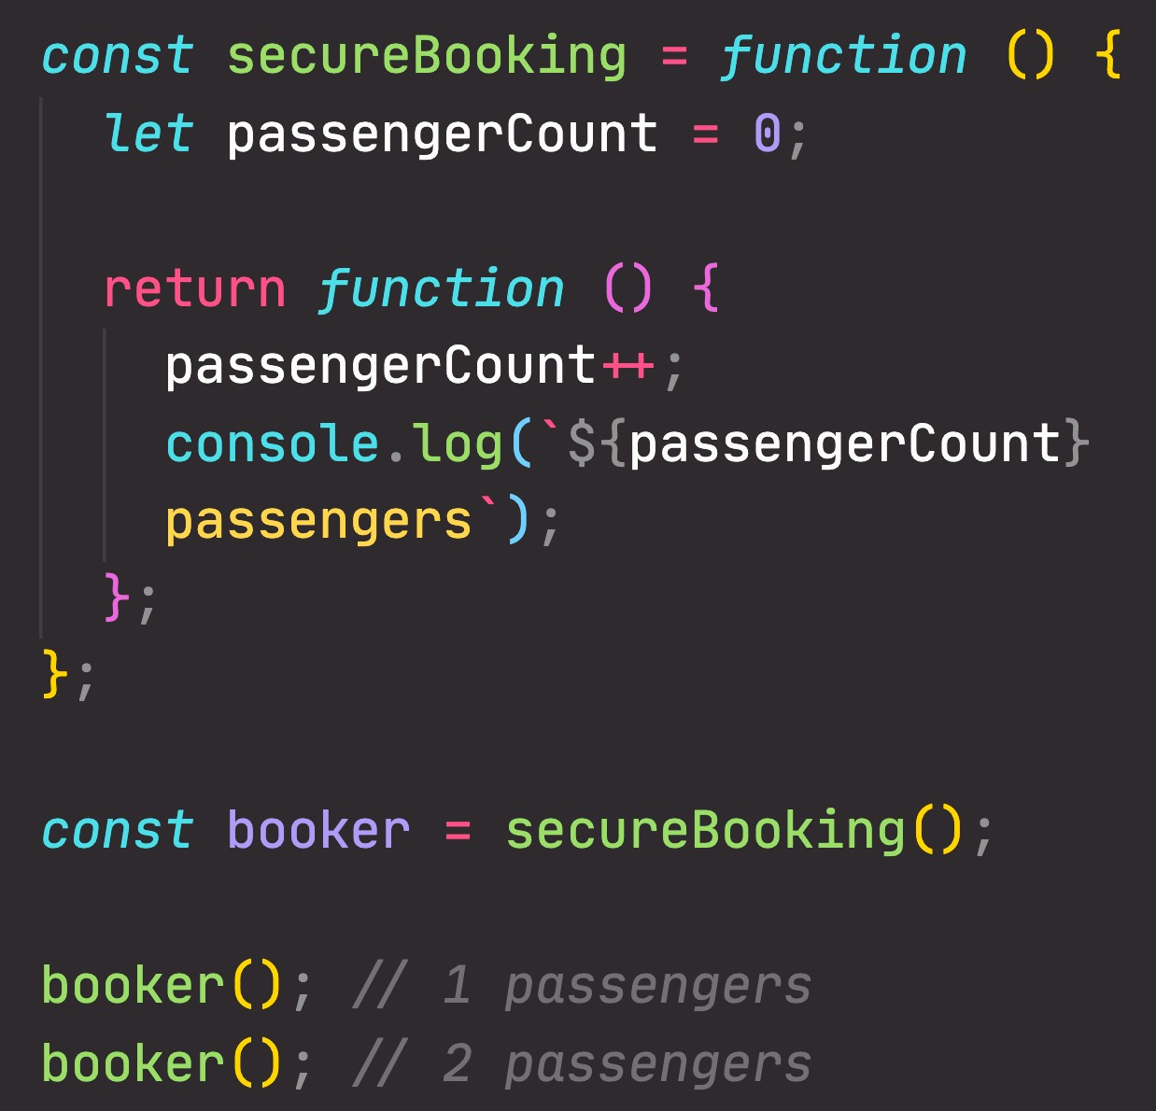

UNDERSTANDING CLOSURES
secureBooking() EC
Variable Environment of Execution Context in which booker was created
Global scope
passengerCount = 0
passengerCount = 0
secureBooking = <f>
booker = <f>
secureBooking() scope
passengerCount = 0
secureBooking = <f> booker = <f>
booker() EC
<empty>
This is the function
booker() scope
<empty>
secureBooking = <f> booker = <f>
Global EC
secureBooking = <f>
booker = <f>
CALL STACK
How to access
passengerCount?
SCOPE CHAIN

Slide 63
UNDERSTANDING CLOSURES
A function has access to the variable environment (VE) of the execution context in which it was created
Closure: VE attached to the function, exactly as it was at the time and place the function was created
Global scope
secureBooking = <f>
booker = <f>
secureBooking() scope
passengerCount = 0
secureBooking = <f> booker = <f>
booker() EC
(Priority over scope chain)
CLOSURE
<empty>
This is the function
booker() scope
<empty>
secureBooking = <f> booker = <f>
Global EC
01
secureBooking = <f>
booker = <f>
passengerCount = 2
CALL STACK
How to access
passengerCount?
SCOPE CHAIN

Slide 64
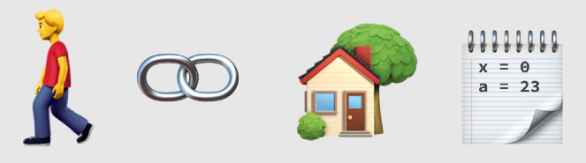
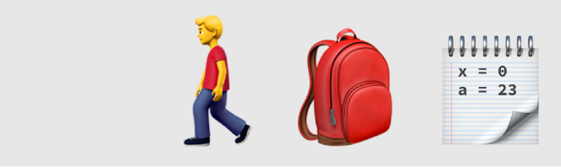
CLOSURES SUMMARY
A closure is the closed-over variable environment of the execution context in which a function was created, even after that execution context is gone;
Less formal
A closure gives a function access to all the variables of its parent function, even after that parent function has returned. The function keeps a reference to its outer scope, which preserves the scope chain throughout time.
Less formal
A closure makes sure that a function doesn’t loose connection to variables that existed at the function’s birth place;
Less formal
Function Connection Parent scope Variables
A closure is like a backpack that a function carries around wherever it goes. This backpack has all the variables that were present in the environment where the function was created.
Function
Closure
Variables
We do NOT have to manually create closures, this is a JavaScript feature that happens automatically. We can’t even access closed-over variables explicitly. A closure is NOT a tangible JavaScript object.

